Slide 1
Upstream processes
Hire to retire
Downstream processes
Acquire to dispose
Pay employees
Manage travel and expenses
Acquire to dispose
Case to resolution
Forecast to plan
Plan to produce
Procure to pay
Product and service lifecycle management
Project to profit
Record to report
Service to cash
Case to resolution
Forecast to plan
Inventory to deliver
Order to cash
Plan to produce
Procure to pay
Product and service lifecycle management
Project to profit
Record to report
Service to cash
Plan and recruit your workforce
Onboard and manage the employee lifecycle
Manage employee performance and growth
Manage occupational health and safety
Administer employee and manager requests
Manage employee benefits and compensation
Manage employee time and attendance
Order to cash
Notes:
End to end process relationship diagram example
Order to cash process relationship
The following diagram shows the relationship of other processes and products/features for the order to cash process. The prerequisites for the order to cash process include product design to retire and prospect to quote processes. The order to cash end-to-end process is broken down into the following business process areas including:
Manage pricing and contracts
Create and manage sales orders
Trade across companies
Issue customer invoices
Record customer payments
Monitor customer credit and collections
Process customer rebates
The third column in the diagram displays the downstream business process which includes inventory to deliver, case to resolution, and record to report. In some operating strategies, such as make to order or purchase to order, the procure to pay and plan to produce end-to-end processes may be part of the downstream business process flow. However, this article does not detail those scenarios. The final column in the graphic displays additional capabilities in Dynamics 365 that are dependent on the order to cash process to include, but not limited to Sales accelerator, Demand forecasting, Customer insights, Finance insights, Dynamics 365 Fraud Protection, Dynamics 365 Intelligent Order Management.

Slide 2
Hire to retire
Start
Acquire to dispose
Acquire to dispose
Acquire to dispose
Plan and recruit your workforce
Case to resolution
Case to resolution
Case to resolution
Onboard and manage the employee lifecycle
Forecast to plan
Forecast to plan
Forecast to plan
Inventory to deliver
Manage employee performance and growth
Inventory to deliver
Inventory to deliver
Order to cash
Order to cash
Manage occupational health and safety
Order to cash
Plan to produce
Plan to produce
Plan to produce
Administer employee and manager requests
Procure to pay
Procure to pay
Procure to pay
Manage employee benefits and compensation
Product and service lifecycle management
Product and service lifecycle management
Product and service lifecycle management
Manage employee time and attendance
Project to profit
Project to profit
Project to profit
Manage travel and expenses
Record to report
Record to report
Service to cash
Pay employees
Service to cash
End
Notes:
End to end process flow diagram sample
The following diagram shows the high-level flow of the order to cash business process. Each solid rectangle on the diagram represents an end-to-end business process area. The sub-processes shown in the diagram are shown for the order to cash business process. The arrows on the diagram show the flow of the business process in an organization. If a sub-process can lead to more than one other sub-process, the parallel sub-processes are shown as branches.

Slide 3
Hire to retire
Start
Acquire to dispose
Acquire to dispose
Plan and recruit your workforce
Case to resolution
Case to resolution
Forecast to plan
Onboard and manage the employee lifecycle
Forecast to plan
Inventory to deliver
Manage employee performance and growth
Order to cash
Order to cash
Manage occupational health and safety
Plan to produce
Plan to produce
Administer employee and manager requests
Procure to pay
Procure to pay
Manage employee benefits and compensation
Product and service lifecycle management
Product and service lifecycle management
Manage employee time and attendance
Project to profit
Project to profit
Manage travel and expenses
Record to report
Record to report
Service to cash
Pay employees
Service to cash
End
Notes:
End to end process flow diagram sample
The following diagram shows the high-level flow of the order to cash business process. Each solid rectangle on the diagram represents an end-to-end business process area. The sub-processes shown in the diagram are shown for the order to cash business process. The arrows on the diagram show the flow of the business process in an organization. If a sub-process can lead to more than one other sub-process, the parallel sub-processes are shown as branches.

Slide 4
Notes:
Simple flow diagram template

Slide 5
Notes:
Smart art list sample

Slide 6
Template for business process, patterns, and practices

Slide 7
Brand and accent colors accessibility
Type and background combinations must meet a minimum 4.5:1 contrast ratio to help ensure people of all abilities can access and understand our communications.
Pick colors carefully and avoid relying on color alone to convey information. Always provide text or other graphical cues to guide customers to our message.
Examples demonstrate correct color use for on-screen applications.
Get the Color Contrast Analyzer
Get more information on accessibility
Get the Microsoft color guidelines PDF
Dark Orange
Rich Black
R255 G147 B73 Hex #FF9349
Dark Yellow
Rich Black
R254 G240 B0 Hex #FEF000
Dark Green
Rich Black
R155 G240 B11 Hex #9BF00B
Dark Teal
Rich Black
R48 G229 B208 Hex #30E5D0
Dark Blue
Rich Black
R80 G230 B255 Hex #50E6FF
Dark Purple
Rich Black
R213 G157 B255 Hex #D59DFF
White
Rich Black
R216 G59 B1
Hex #D83B01
Rich Black
R255 G185 B0
Hex #FFB900
White
R16 G124 B16
Hex #107C10
White
Rich Black
R0 G133 B117
Hex #008575
White
Rich Black
R0 G120 B212
Hex #0078D4
White
Rich Black
R134 G97 B197
Hex #8661C5
Light Orange
White
R107 G41 B41 Hex #6B2929
Light Yellow
White
R106 G75 B22 Hex #6A4B16
Light Green White
R5 G75 B22 Hex #054B16
Light Teal
White
R39 G75 B71 Hex #274B47
Light Blue
White
R36 G58 B94 Hex #243A5E
Light Purple
White
R59 G46 B88 Hex #3B2E58
White
R255 G255 B255
Hex #FFFFFF
Orange
Dark Orange
Dark Yellow
Green
Dark Green
Teal
Dark Teal
Blue
Dark Blue
Purple
Dark Purple
Rich Black
R0 G0 B0
Hex #000000
White
Light Orange
Orange
White
Light Yellow
Yellow
White
Light Green
White
Light Teal
Teal
White
Light Blue
Blue
White
Light Purple
Purple
Extra Light Gray
R242 G242 B242
Hex #F2F2F2
Light Gray
R230 G230 B230
Hex #E6E6E6
Gray
R210 G210 B210
Hex #D2D2D2
Mid Gray
R115 G115 B115
Hex #737373
Dark Gray
R80 G80 B80
Hex #505050
Extra Dark Gray
R47 G47 B47
Hex #2F2F2F

Slide 8
Slide palette info
The PowerPoint palette for this template has been built for you and is shown below.
Avoid using too many colors in your presentation.
PowerPoint Theme Accent colors
Accent 1
Accent 2
Accent 3*
Accent 4
Accent 5
Accent 6
Use Accent 1 as the main accent color.
Use Accent 2 and Accent 3 only when additional colors are needed.
*Ensure text on Accent 3 has sufficient size and weight to meet color contrast ratios.
Use Accents 4-6 sparingly

Slide 9
Chart design

Slide 10

Ensure slide content is accessible
Take the following steps to create accessible content that everyone can consume effectively.
Contrast
Use high contrast colors for maximum readability
The recommended contrast ratio is at least 4.5:1
Shape and color
Use different shapes with a legend to indicate statuses to accommodate for color blindness
Example:
Alt text
Alt text helps people with screen readers understand the content of slides
You should create alternative text for shapes, pictures, charts, tables, SmartArt graphics, or other objects
Here’s how:
Right click on item
Select Edit Alt Text
Enter a Description
If an object is meant to add visual styling and doesn’t contain meaning (e.g. stylistic borders), do not add alt text and instead check Mark as decorative
Slide layouts
Using a built-in slide layout that matches your content ensures a hierarchical reading order of text blocks
Example:
If a new slide will have a title, rather than starting with a blank layout and adding a text block for the title, choose one of the built-in layouts with a title placeholder
Reading order
Screen readers describe content on the screen in the order it was created
To ensure your content is read back in the order you prefer, arrange your objects in the Selection Pane appropriately. Objects on the bottom of the selection pane are read first
Here’s how:
Click the Home tab
In the Drawing group, select the Arrange drop-down menu
Click Selection Pane…
Subject 1
Subject 2
Subject 3
Color Contrast Analyzer
Download this tool to determine the legibility of text and the contrast of visual elements
Download
C1
C2
C3
Additional tips
Be sure to run the Accessibility Checker! Go to File click the Check for Issues drop down menu click Check Accessibility
Videos need to be accessible: If your presentation includes a video, ensure it is captioned and audio described (if appropriate)
Visit the Office Accessibility Center to learn more about accessibility in PowerPoint

Slide 11
Text layout (without bullet points)
Main topic: Segoe UI, size 28pt
Segoe UI, size 20pt for second level
Segoe UI, size 16pt for third level

Slide 12

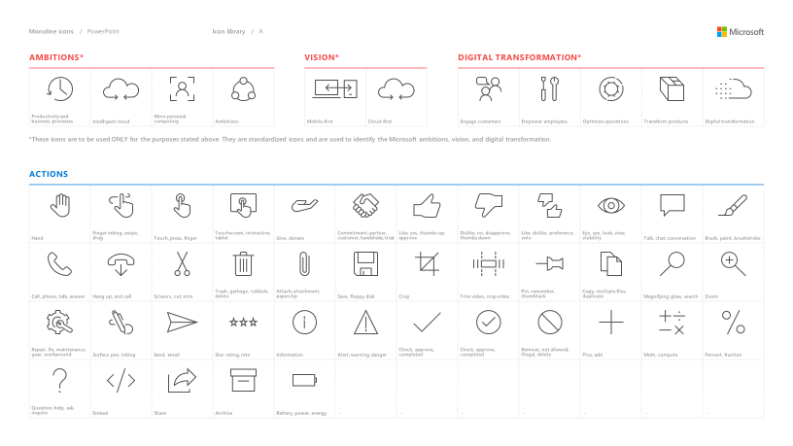
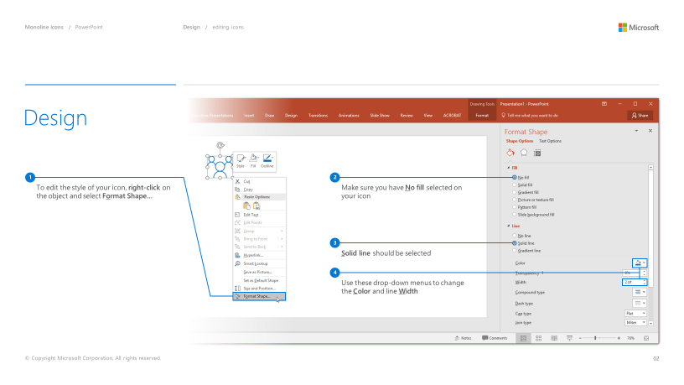
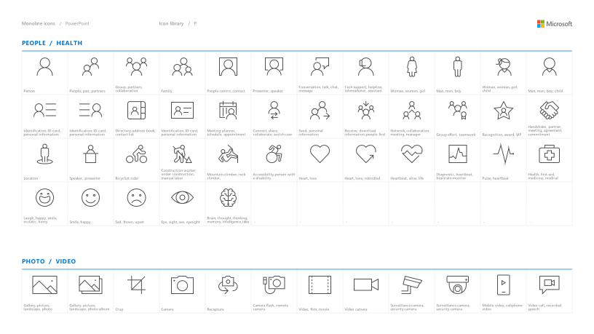
Microsoft monoline icons
Looking for icon resources?
The Monoline icon library for PowerPoint is a slide deck that provides a library of icons for use in PowerPoint presentations.
The Monoline icon style guide for PowerPoint is a pdf with additional guidelines.
Download both from Brand Central.

